Slide 1
COVID-19 Social Story
Special Needs Dental Team

Slide 2
Things have changed a bit since COVID-19 at our clinic.
Follow our social story to see how things have changed.
We will also show you through our new entrance and our new outfits.
We are now asking patients to wait in their car when they arrive, call us at reception to inform that you have arrived. Once ready the staff will collect you from your car. If coming by Taxi call us at reception and we will come out and greet you.

Slide 3
Our Carpark

Slide 4
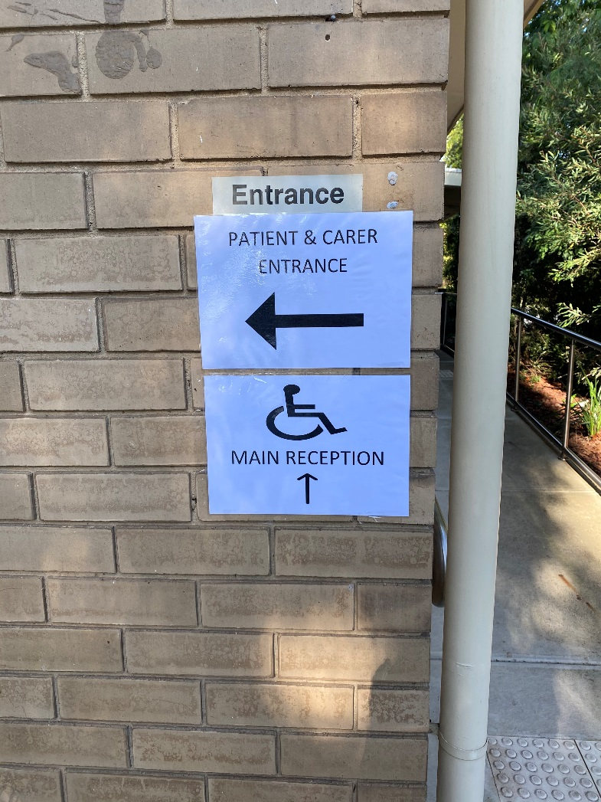
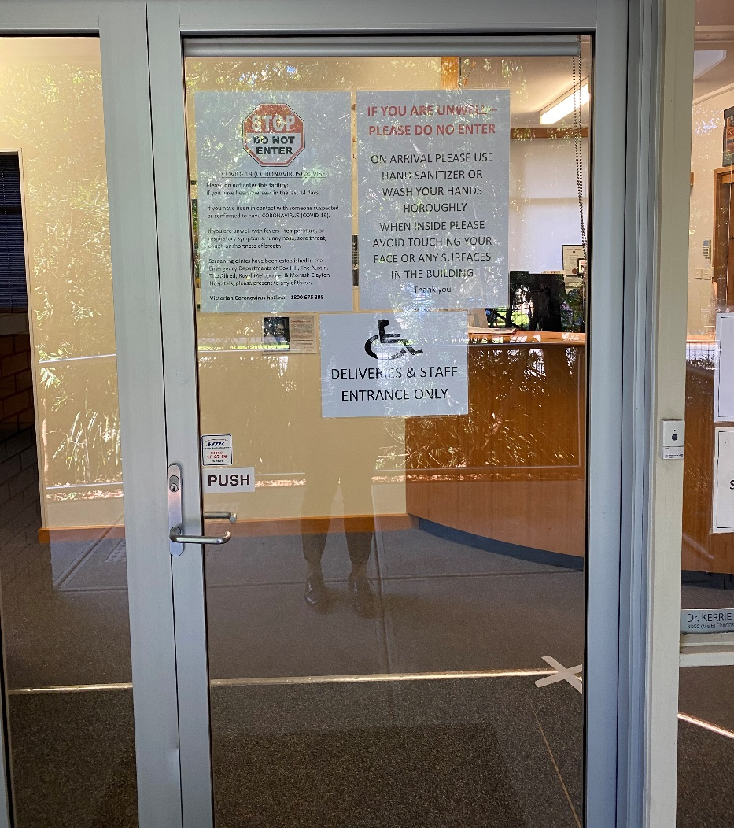
Our new entrance

Slide 5
Temperature checking
We will check your temperature before you enter the clinic.

Slide 6
Sanitise your hands

Slide 7
Once your hands are clean you can now sit in the chair

Slide 8
Once you sit in the chair we will get you to perform a mouthwash

Slide 9
Now you’re ready for us to check your teeth

Slide 10
We may use the suction more in your visit now

Slide 11
Meet Our Staff

Slide 12
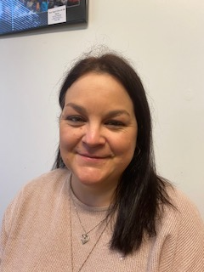
Shona- Receptionist

Slide 13
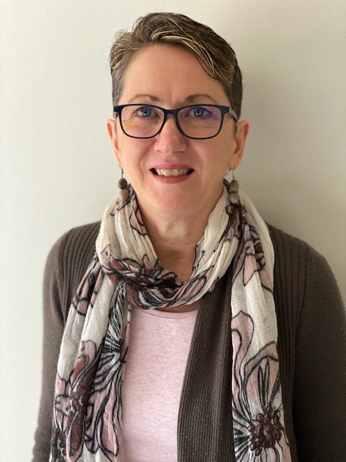
Sue- Receptionist

Slide 14
Dr Kerrie- Special Needs Specialist

Slide 15
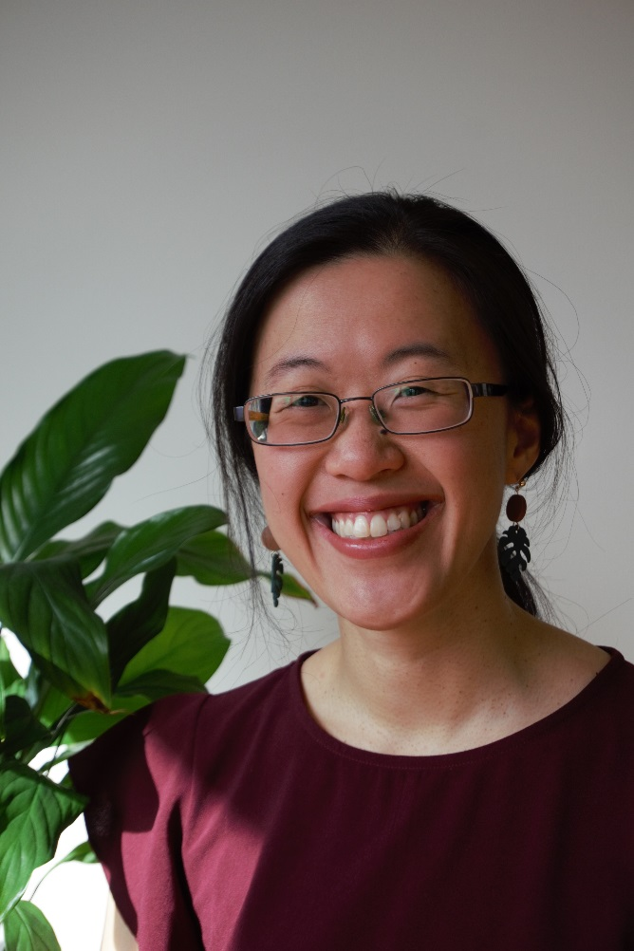
Dr Nikki Liew- Special Needs Specialist

Slide 16
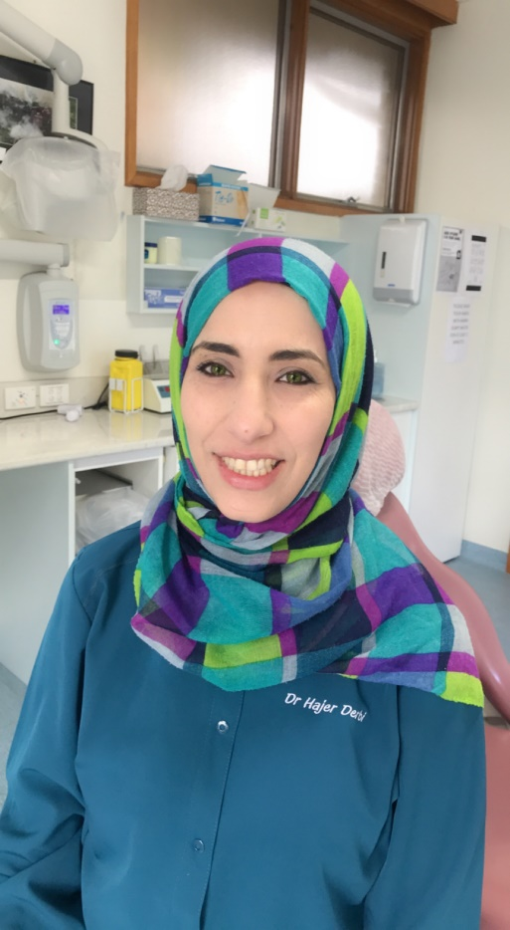
Dr Hajer Derbi- Special Needs Specialist

Slide 17
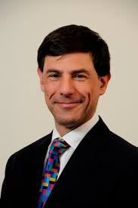
Dr Warren Shnider- Special Needs Specialist

Slide 18
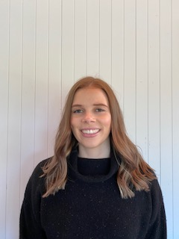
Natalie- Oral Health Therapist

Slide 19
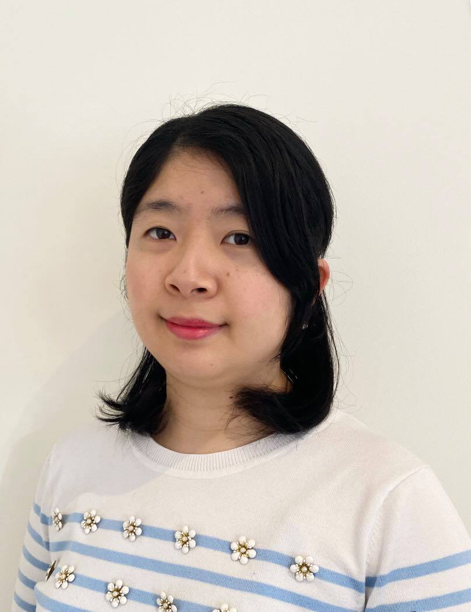
Dr Catherine Fu- Dentist

Slide 20
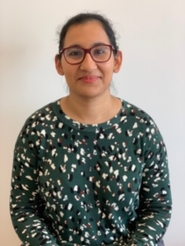
Dr Agam Kaur- Dentist

Slide 21
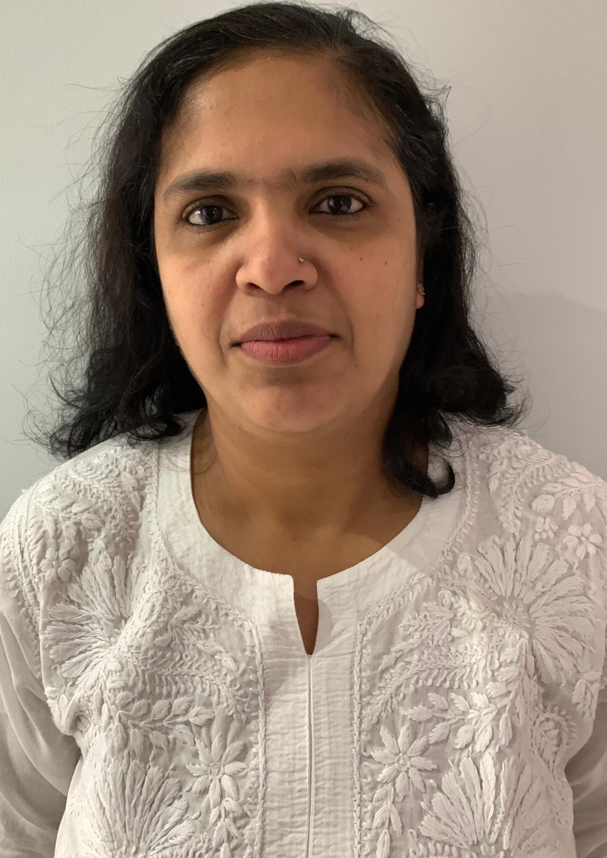
Simi- Dental Assistant

Slide 22
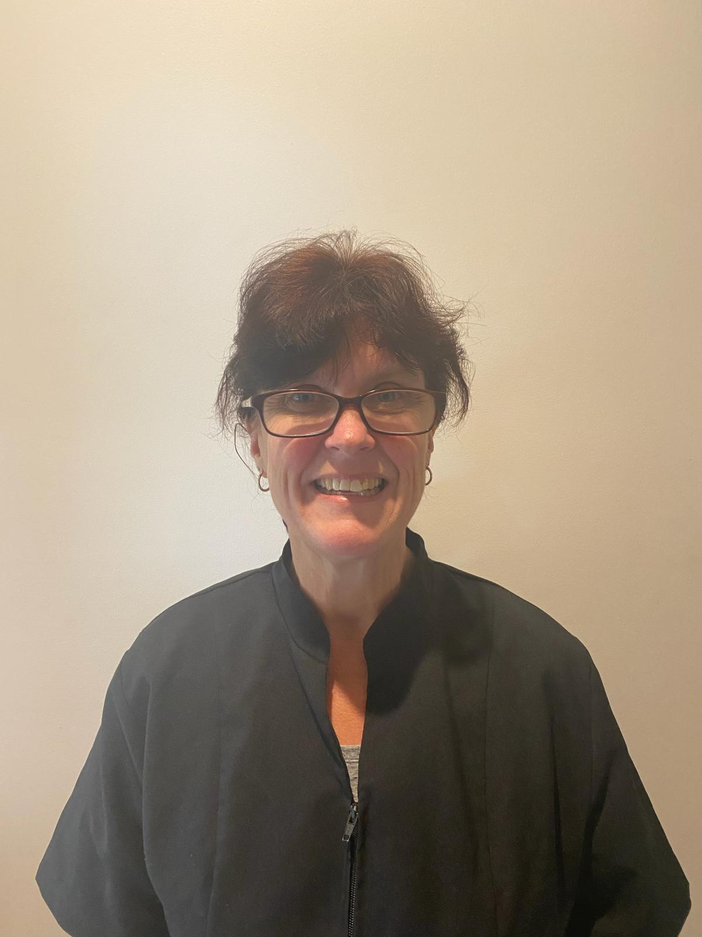
Kerryn- Dental Assistant

Slide 23
We look forward to seeing you soon!

